Slide 1
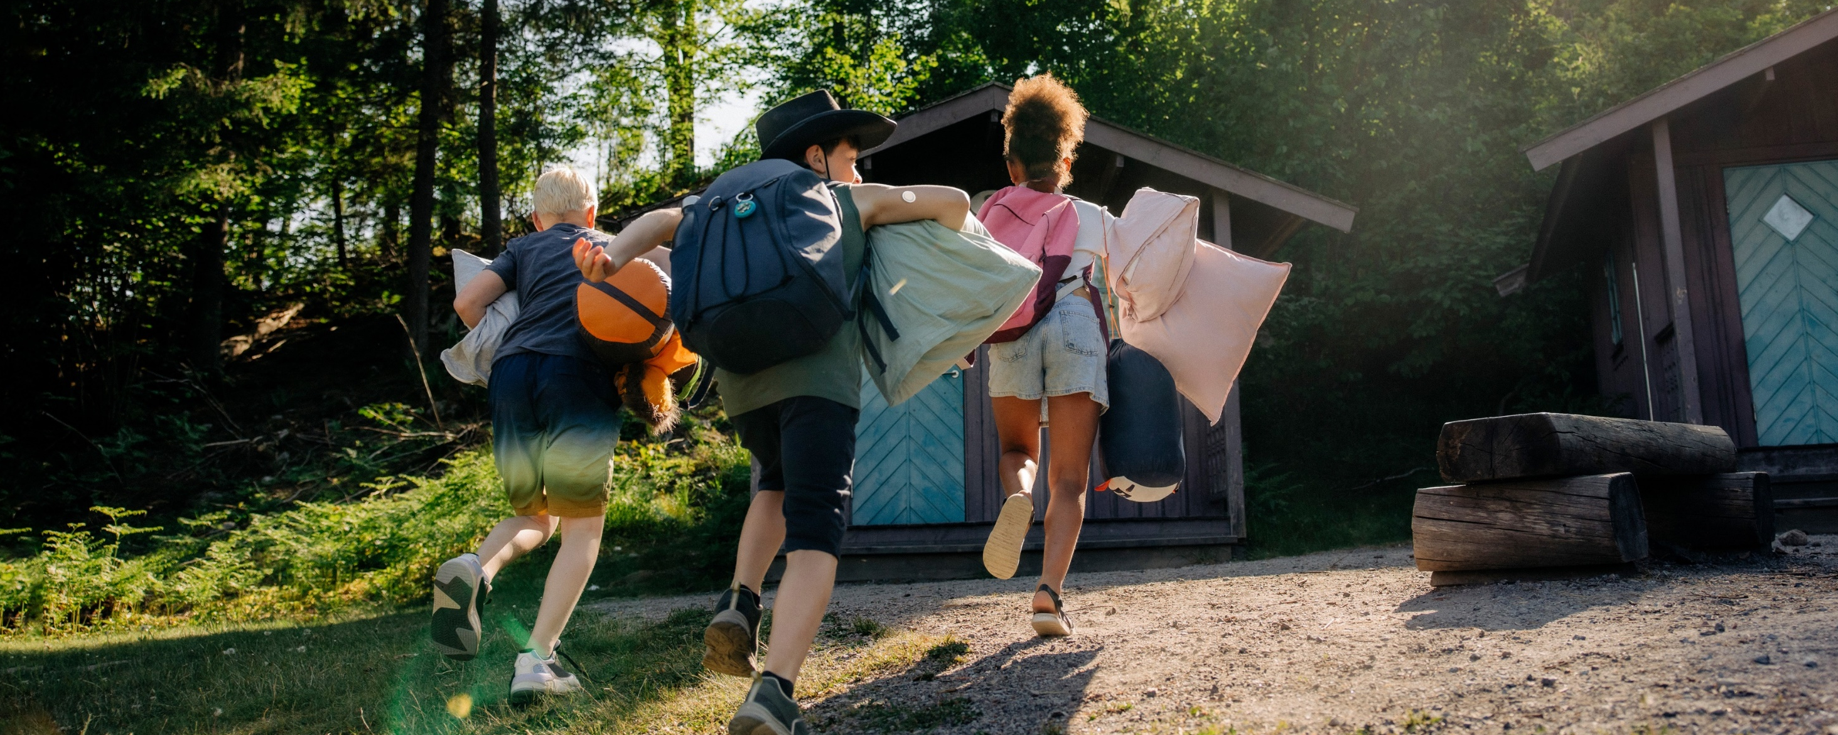

Unlock a world of fun and learning
Encourage parents to consider diabetes camps for their kids

Slide 2
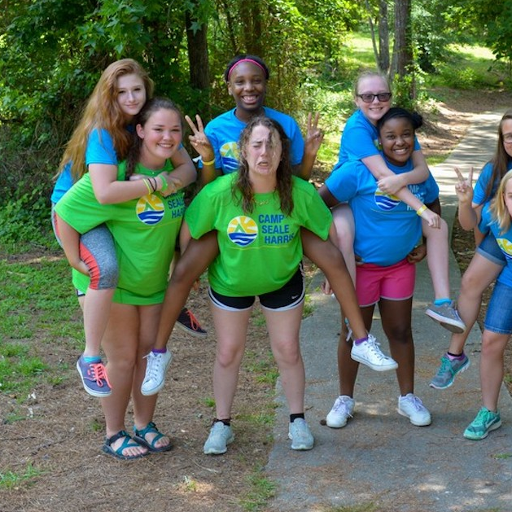
Introduction to DECA (Diabetes Education & Camping Association)
DECA’s mission is to provide a place of belonging for every child with diabetes. ​
This mission is made possible by: ​
Spreading awareness
Improving safety
Providing resources
Connecting camps
Facilitating giving
Fostering diversity
DECA is committed to strengthening the network of camps across the US, so every child with diabetes can access a diabetes camp.
Notes:
We are furthering this mission by: ​
Creating belonging: We spread the word about diabetes camps to help make more people aware
of the impact camp can have and how to find a camp in their area ​
Improving safety: We offer trainings, conference, and other programs to diabetes camp staff so
they are up to date on safest practices ​
Providing resources: We help secure medical supplies, educational resources, and more for diabetes camps to help them stay cutting edge and ready to help campers ​
Connecting camps: We create a network between diabetes camps so they can share their experiences
and help strengthen each other ​
Facilitating giving: We raise funds to sponsor
camperships and to distribute to diabetes camps
for further resources and product donations ​
Fostering diversity: We encourage people from all backgrounds to attend, volunteer at, and support
diabetes camps, working to make sure they are a
safe and inclusive environment for all

Slide 3
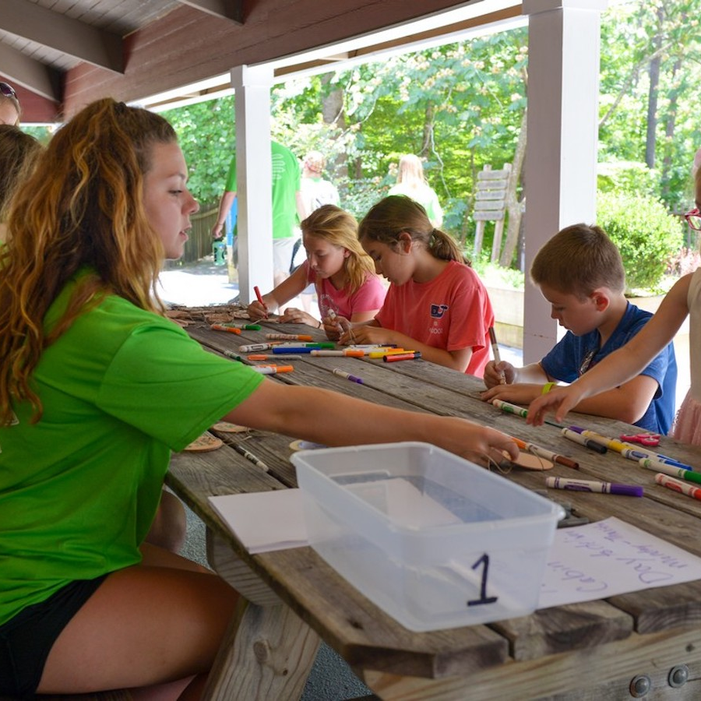
What are diabetes camps?
Living with diabetes isn’t easy, especially for a child or teen. There’s so much to learn for both kids and parents to get prepared for the future. But they don’t have to do it alone.
At diabetes camps, all kids can come together and grow in a safe, helpful environment. They can:
Learn age-appropriate skills to manage their diabetes
Find friends and support that will last a lifetime
Gain confidence and independence
Have some fun in a place where diabetes doesn’t have to be a barrier!
At camp, kids can just be kids. Because every child with diabetes deserves to feel like they belong. ​

Slide 4




At diabetes camps kids can find:
Community where they can meet other people living with diabetes from all backgrounds, learn from their peers, and find friendships that last a lifetime

Slide 5
At diabetes camps kids can find:
Community where they can meet other people living with diabetes from all backgrounds, learn from their peers, and find friendships that last a lifetime
Adventures where they can have fun, learn, and build their confidence—where diabetes doesn't have to be a barrier

Slide 6
At diabetes camps kids can find:
Community where they can meet other people living with diabetes from all backgrounds, learn from their peers, and find friendships that last a lifetime
Adventures where they can have fun, learn, and build their confidence—where diabetes doesn't have to be a barrier
Management tips and training to help set themselves up for success with diabetes in the future ​

Slide 7
At diabetes camps kids can find:
Community where they can meet other people living with diabetes from all backgrounds, learn from their peers, and find friendships that last a lifetime
Adventures where they can have fun, learn, and build their confidence—where diabetes doesn't have to be a barrier
Management tips and training to help set themselves up for success with diabetes in the future ​
Professional support from diabetes educators who can provide one-on-one teaching and care​

Slide 8




CAMP can change the future for kids with diabetes!
Community
Adventures
Management tips
Professional support
Diabetes camps can be a transformative experience for kids of all ages, and their families too.
The skills they learn will be invaluable, and they’ll have the chance to make amazing memories.
Diabetes doesn’t have to make kids feel different. At camp, they’ll find a place to feel like they truly belong, in a space where they're supported, included, and safe when it comes to their diabetes.

Slide 9
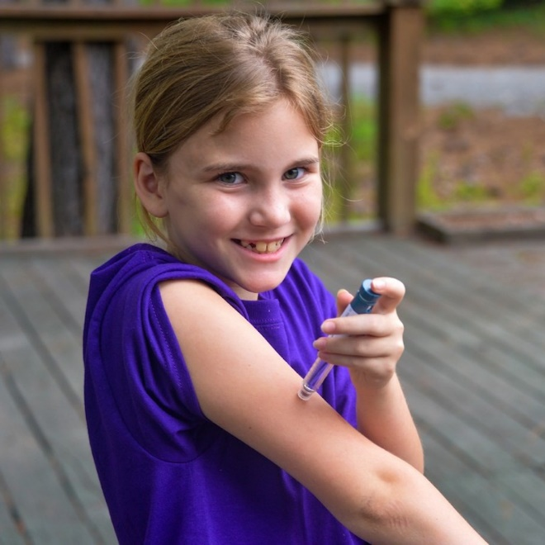

Let’s look at the benefits of diabetes camp by the numbers
According to a survey of previous camp attendees*:
99% of kids who went to camp were able to independently achieve at least one diabetes management skill after camp
These include:
Measuring their blood sugar levels
Drawing up insulin
Giving themselves injections
Rotating injection sites
And more!
63% of campers were always or often able to solve diabetes management problems after attending camp
61% of parents and caregivers stated that their campers’ confidence to interact with their peers was “above average” or “very high” by the end
of camp
*Provided by the American Diabetes Association—Camps Team.

Slide 10

Parents can have peace of mind
The thought of sending kids away overnight can be scary for any parent. But diabetes camps are designed for your child, with their safety in mind.
Diabetes camps are run by experts in managing diabetes—and in training kids to take on age-appropriate care. Some ways that diabetes camps work to keep kids safe are: ​
Creating an environment designed for healthy management of diabetes
Having medical experts and educators available to provide care ​
Ensuring all camp staff are fully trained in diabetes management—in fact, many counselors have diabetes themselves
Working together with kids to make sure they feel supported, both physically and emotionally

Slide 11

Are diabetes camps expensive?
Cost shouldn’t be a barrier that stops kids from being able to go to diabetes camp.
Each camp has different fees, but most of them charge fees that are much lower than their actual costs, to help camp be more affordable.
Most diabetes camps also provide financial assistance to cover some or all of the costs, depending on household income. ​Once a parent finds a diabetes camp they’re interested in, they can call or email the camp staff to learn more about overall cost or financial assistance.

Slide 12

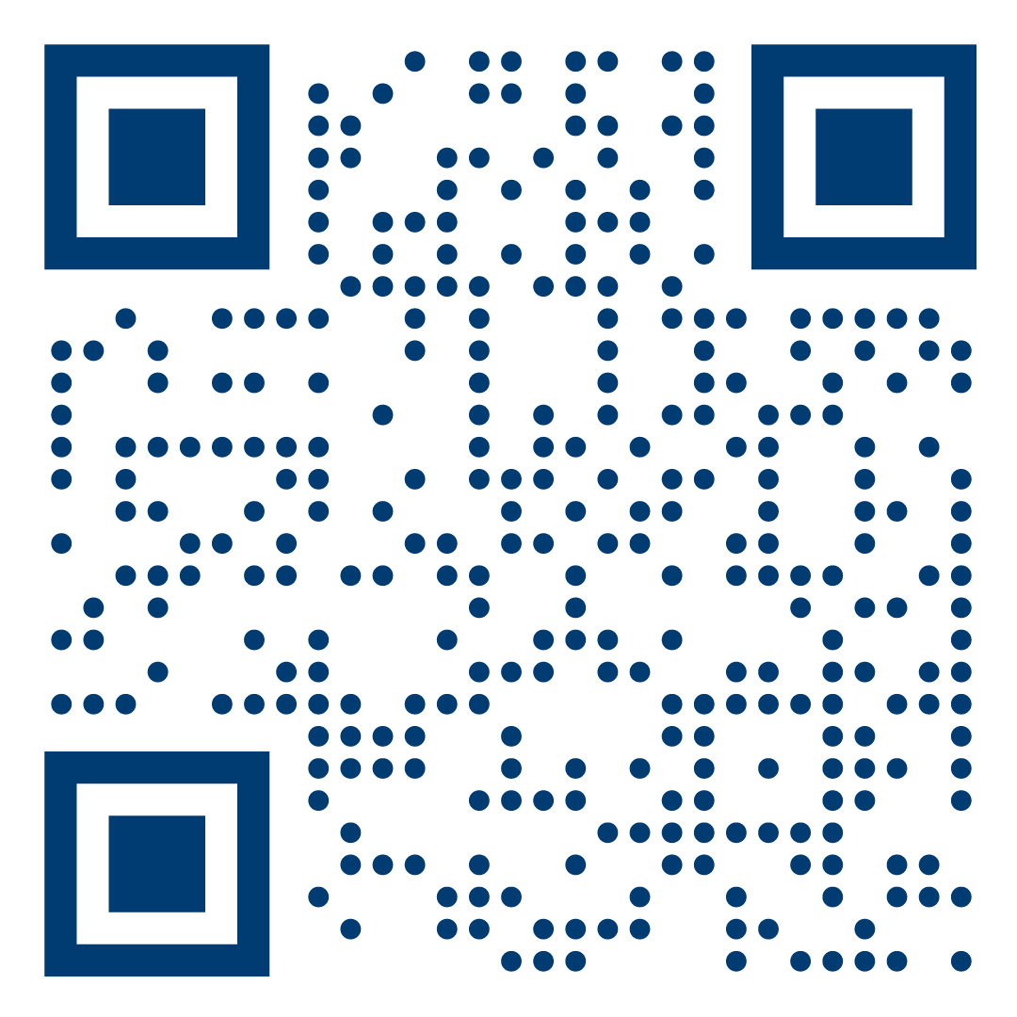
How can you support diabetes camps?
Diabetes camps help build a strong community and also rely on a strong community to operate.
Your voice and expertise can help us realize our mission of a world where everyone with diabetes has a place to belong.
Many diabetes camps need support with training and education or professionals to join camp staff.
Visit diabetescamps.org to find volunteer opportunities
(at a camp near you)!

Slide 13
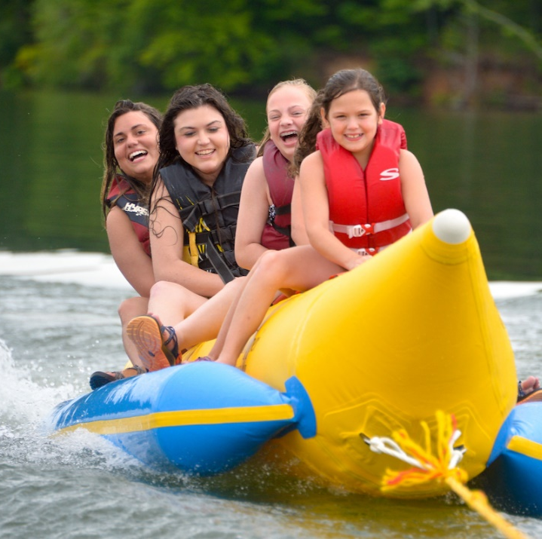
Encourage parents to consider diabetes camps for their families
You can have a big impact in spreading the word about diabetes camps.
Talk to parents and kids about the value of camping and how it can change their future.
Visit diabetescamps.org/find-a-camp to find a camp near you!

