Slide 1
Ages and Stages of Youth Development

Slide 2
Agenda
Characteristics of Development
Age 8-10
Age 11-12
Age 13-16

Slide 3
Characteristics of Development
Physical
Social
Emotional
Intellectual

Slide 4
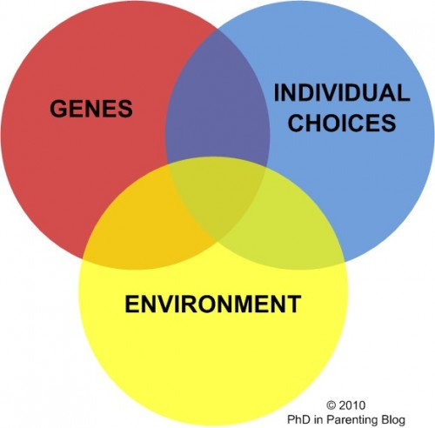
Who/What Influences Growth and Development?
Parents
Caregivers
Teachers
Coaches
Extended Family
Peers/Friends
Community
Media
Heredity
Environment

Slide 5
Principles of Development
Orderly, not random
Continuous and Gradual Process
Varying Pace
Unique Temperament
Larger Context

Slide 6
Ages 8-10
Jot down three characteristics you think of when you envision 8-10 year olds

Slide 7
Characteristics of 8-10
Physical
Social
Active
Growth spurt
Maturity
Implications?
Limited understanding of others viewpoints
Make others happy
Please adults with successful completion of activities
Implications?

Slide 8
Characteristics of 8-10
Emotional
Intellectual
Moody
Individual Identity – Mimic
Fair and Equal
Question authority – guidance from adults
Implications?
Black/white
Learning their favorite subjects, activities, and interests
Find solutions to problems
Implications?

Slide 9
Ages 11-12
Jot down three characteristics you think of when you envision 11-12 year olds

Slide 10
Characteristics of 11-12
Physical
Social
Many changes
Girls are developing and concerned about body image
Implications?
Activities involving opposite sex
Interested in opinion of peers
Adult role models
Opinionated and independent
Implications?

Slide 11
Characteristics of 11-12
Emotional
Intellectual
Compares themselves to others
All about ME!
Emotions are a roller-coaster
Implications?
Gaining study skills
Learning abstract thinking
In-depth and long-term experiences
Fantasy to reality
Implications?

Slide 12
Ages 13-16
Jot down three characteristics you think of when you envision 13-16 year olds

Slide 13
Characteristics of 13-16
Physical
Social
Body image- concerned
Implications?
Activities involving opposite sex
Search for intimacy
Desire for respect
Implications?

Slide 14
Characteristics of 13-16
Emotional
Intellectual
Developing:
Confidence
Independence
Gaining respect
Uniqueness
Values and beliefs
Tasks without supervision
Implications?
Mastering abstract thinking
Behavior impacts future
Show others learning
No to meaningless activities
Implications?

Slide 15
Practical Implications
Younger Children:
Limited by developmental capacities
Organize activities & events that are age appropriate
Active involvement over competition
Be generous with praise
Encourage exploration
Clear rules, boundaries, and structure
Adolescents/teens:
Encourage emerging independence – maintain rules/structure
Sensitive to self-image issues
Open to discussing sensitive issues
Foster positive peer interaction
Provide constructive criticism along with positive feedback
Promote experiential learning opportunities

